Slide 1




The Army Combat Fitness Test (ACFT) Leg-Tuck Event Instructional Unit
Kevin M. Schuller
IDE 737-Advanced Instructional Design (Capstone)
26 May 2021
Professor
Dr Tiffany Koszalka
Syracuse University

Slide 2
Instructional Unit Program Overview
UNIT Title: The ACFT Leg-Tuck Event Designer: Kevin M. Schuller
Purpose: Train Army Team Leaders on a proper training plan and execution of the leg-tuck event. This instruction will increase the soldier's ability the correctly perform the exercise leading to an increased performance on the ACFT. Seat-time: 2 Hours
Context: The ACFT is a six-event combat focused fitness test that measures the overall fitness level of every Soldier enlisted within the United States Army. Commanders at every echelon use the results of the ACFT to help assess the level of fitness for each unit. This assessment allows a reportable measurement for the unit's ability to conduct full spectrum operations within a multi-domain environment. The Leg-Tuck (LTK) event is the 5th event with the fitness assessment that aims at measuring the strength of the soldier's grip, arm, shoulder, and trunk muscles. This event helps the commander assess the soldier's ability to carry heavy loads over distance and various terrains. This minimum number of repetitions for this exercise must be successfully completed by each soldier either annually or semi-annually by every component (Active, Reserve, National Guard) as a condition of service requirement. In addition, performance within this event affects all favorable actions for every soldier to include retention, promotions, military schools, and awards.
Target Audience: This instruction applies to every soldier enlisted or commissioned within the United States Army for all three components (Active Duty, Reserves, National Guard). The instruction is applicable not only to all three components but also includes all career management fields within the United States Army.
Expected UNIT outcomes: Upon certification of this instructional unit team leaders within the United States Army will have the knowledge and skills to properly:
In a classroom environment team leaders will describe and demonstrate the knowledge necessary to build an effective training program, within their unit, to successfully prepare soldiers in their formation for execution of the ACFT leg-tuck event.
Provide the Army total force structure with certified trainers that can demonstrate on an (approved physical readiness training field) they can properly individually execute and train soldiers for the ACFT Leg-Tuck event.
Overview: This instructional unit a 120-minute classroom face-to-face experience that will include classroom education and Physical Readiness Hands-on Training, In addition, students will be presented with an additional 120-minutes of practical application in the field before the final assessment. The unit of instruction will begin with video presentations and lectures of correct leg-tuck execution and the three applicable training exercises as dictated within the Army TC 3-22.20. The students will then in a classroom under facilitator supervision collaboratively develop a one-week small unit physical readiness training plan that will aims to increase human performance within the ACFT leg-tuck event. Upon completion of the classroom portion of instruction the students will be shown the proper execution of the leg-tuck event and three approved training exercise using the Army by the number's method of demonstration on an approved PRT filed. The students will be given the opportunity to practice and demonstrate the skills of the leg-tuck and three training exercises. Finally, the students will move under facilitator supervision back to their units where they will apply newly formed leg-tuck skills into training application. The course concludes with an assessment that will be given upon completion of the 120-minute field application.

Slide 3
Instructional Unit Program Overview
UNIT Title: The ACFT Leg-Tuck Event Designer: Kevin M. Schuller
Purpose: Train Army Team Leaders on a proper training plan and execution of the leg-tuck event. This instruction will increase the soldier's ability the correctly perform the exercise leading to an increased performance on the ACFT. Seat-time: 2 Hours
Key UNIT content: Small unit Army team leaders will be introduced to the ACFT leg-tuck exercise. This introduction will include the correct way to maintain relative vertical posture on approved Army climbing bar while moving the hips and knees to the elbow position and back down without excessive swinging. Army Team leaders will also receive introduction and training on the three approved training exercises found in TC 3-22.20 that include the Bent-Leg Raise (BLR), Leg-Tuck and Twist (LTT), Alternating Grip Pull-Up (AGP). Army Team Leaders will not only be introduced to these training events but will also receive lecture on how to incorporate the events into existing physical readiness plans to improve soldier performance. Army team leaders will be able to apply new skills and knowledge at unit level and prove proficiency in understanding proper ACFT leg-tuck execution and proper training exercise planning and implementation.
Content learning assessments: During this instructional unit students will be administered three separate assessments as follows:
Pre-Assessment-5 question assessment with the purpose to identifying and building upon already established foundational concrete knowledge of the leg-tuck event and the three alternate approved training events IAW TC 3-22.20.
Post Course Assessment-10 question post course written assessment and hands-on performance of the leg-tuck event and the three alternate approved training events IAW TC 3-22.20.
Resources required for UNIT: Ice Breaker Videos, Student Name Tags, Instructor Guide, Student Handouts, Demonstration Videos, Stopwatch, Approved Army Climbing Bars, Internet Access, assessments (pre/post), clipboards, leg-tuck performance checklist, Bent-Leg Raise performance checklist, Leg-Tuck and Twist performance checklist, Alternating Grip Pull-Up performance checklist, weekly small unit readiness calendars.
Facilities required for UNIT:
1. Noncommissioned Officer Leader Center of Excellence Ultima Physical Readiness Field
2. Noncommissioned Officer Leader Center of Excellence SGM-A Classroom with applicable smart board technology, instructor stations, Wi-Fi access, student workstations

Slide 4
Content Hierarchy Diagram
UNIT Title: The ACFT Leg-Tuck Event Designer: Kevin M. Schuller
Purpose: Train Army Team Leaders on a proper training plan and execution of the leg-tuck event. This instruction will increase the soldier's ability the correctly perform the exercise leading to an increased performance on the ACFT. Seat-time: 2 Hours
Content Hierarchy: The following content hierarchy diagram shows overall performance and ALL key knowledge/skills required to be competent for this instructional course unit.
Design and Develop unit training and conditioning plan
Demonstrate and execute ACFT Leg-Tuck Event
Demonstrate and execute approved LTK training exercises
Detailed Oriented
Decision Making
LTT
AGP
Hand Strength
Leg Swing Technique
BLR
Creative
Knowledge Base
Flexible
Core Strength
Core Strength
Core Strength
Upper Body Strength
Proper Grip
Understand FM 7-22.1 requirements for LTK
Intellectual
Strength
Strength
Expertise
Training
Training
Education
Conditioning
Conditioning
Experience
Core Strength
Research
Read
Education
Goal Oriented
Strength
Understand FM 7-22.1 requirements for TE’s
Training
Purposeful
Intentional
Quick Thinker
Confident
Education
Conditioning
Read
Research

Slide 5
Instructional Unit Flow Diagram
UNIT Title: The ACFT Leg-Tuck Event Designer: Kevin M. Schuller
Purpose: Train Army Team Leaders on a proper training plan and execution of the leg-tuck event. This instruction will increase the soldier's ability the correctly perform the exercise leading to an increased performance on the ACFT. Seat-time: 2 Hours
UNIT Flow Chart of EVENTS: The following flow chart represents the five lines of effort for the instructional unit. This includes bullet breakdown of the various instructional components within each line of effort.
Presentation
45 minutes
Hands On Practice
30 minutes
Unit Application
120 minutes
Evaluation/ Conclusion
30 minutes
Introduction
15 Minutes
Course Introductions
Course Overview
Issue Course Materials
Pre-Test
Ice Breaker
How to develop small unit PRT plan (leg tuck)
Purpose Leg Tuck event
Leg Tuck exercise
Bent Leg Raise exercise
Leg Tuck and Twist exercise
Alternating Grip Pull execution
Leg Tuck exercise demonstration
Bent Leg Raise exercise demonstration
Leg Tuck and Twist exercise demonstration
Alternating Grip Pull exercise demonstration
Students execute practice on the leg tuck, bent leg raise, leg tuck and twist, alternating grip pull
Individual knowledge reflection
Develop & Execute a two-day PRT plan.
Leg Tuck exercise unit implementation
Bent Leg Raise exercise unit implementation
Leg Tuck and Twist exercise unit implementation
Alternating Grip Pull exercise unit implementation
Individual knowledge reflection
Written Post Test
Leg Tuck and Twist Event Evaluation
End of course assessment
Turn-in course materials
Certificate Presentations

Slide 6
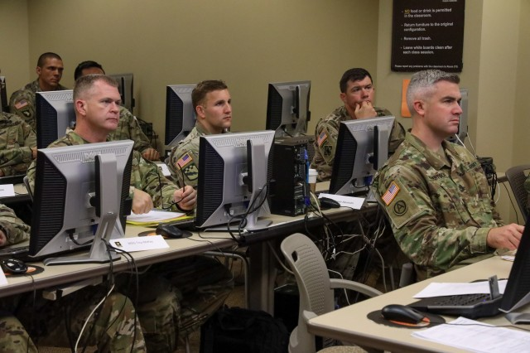
Unit Title: The ACFT Leg Tuck Event Activity Title: Introduction Estimated Time: 15 Minutes
 | Instructional Activity Description Course Introductions Course Overview Issue Course Materials Pre-Test
 | Activity Deliverables/Outcomes: Students are greeted and introduced by the instructor Students provide brief introduction of themselves Overview and issuance of Course Materials to students
 | Resources Required: Instructor Guide Student Folders with handouts and student guide NCOLCE Classroom with student and instructor stations Pre-Test Assessments Wi-Fi and Internet Access Student Name Tags Markers Scratch Paper
Notes: Create a one slide introduction slide for instructor that includes necessary information Create five question pre-test to reflect on previous knowledge and skills | Key learning objectives / sub-objectives: Students will have understanding (blooms taxonomy) of course expectations, goals, and objectives Students will have access and understanding (blooms taxonomy) to necessary materials and tools available to succeed within the course
 | Key Content Points: Course introductions Course overview Issue course materials and overview

Slide 7

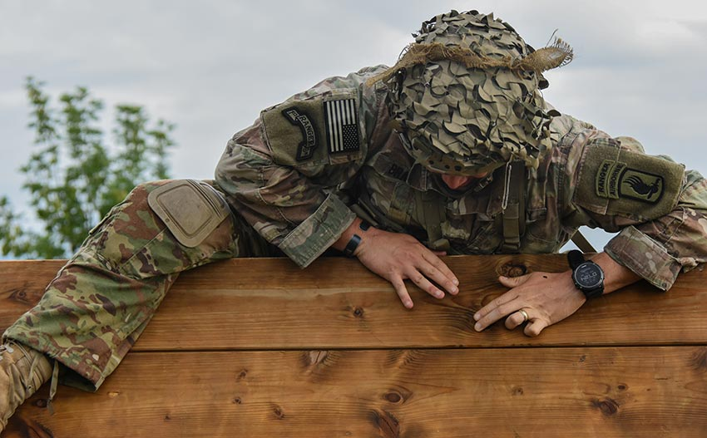
Unit Title: The ACFT Leg Tuck Event Activity Title: Presentation Estimated Time: 45 Minutes
 | Instructional Activity Description Ice Breaker Video Presentation to provide motivation Lecture on “How to” develop small unit PRT plan for leg tuck Lecture based instruction of the purpose of leg tuck event Video presentations and lecture on each of the leg tuck event and the three alternate training exercises (BLR, LTT, AGP)
 | Activity Deliverables/Outcomes: Capture attention with motivational ice breaker video Provide students with lecture-based instruction and video presentation to aide all learner types in the necessary
 | Resources Required: Instructor Guide Student Folders with handouts and student guide NCOLCE classroom with student and instructor stations Wi-Fi and Internet Access Markers Scratch Paper Video Presentations
Notes: Prepare instructor stations and student stations for access to ice breaker video URL: Funny Fitness Video- Have You Done Your Exercises Today Create .PPT presentation on following: a. How to develop small unit PRT plan b. Proper procedures for leg tuck, BLR, LTT, AGP Prepare instructor stations and student stations for videos exercise URLs: | Key learning objectives / sub-objectives: Students will have knowledge and understanding (blooms taxonomy) of the leg tuck event and all three training exercises IAW FM 7-22.1 Students will have the describe and create (blooms taxonomy) on how to effectively establish small unit PRT plan IAW FM 7-0
 | Key Content Points: Attitudes Developing small unit Physical Readiness Training plan Knowledge and understanding of leg tuck and existing three conditioning exercises (Activation of Knowledge)
Video
APPLICATION TO
COMMON SOLDIER
TASKS
Content Video Presentations and Lectures
Leg Tuck
Bent-Leg Raise
Leg Tuck and Twist
Alternating Grip Pull-Up

Slide 8
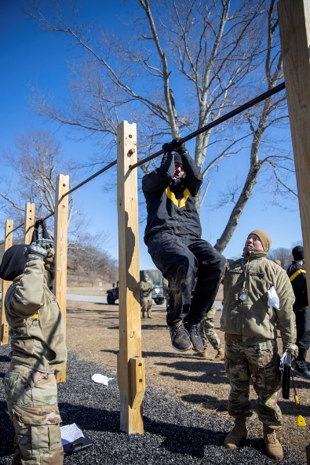
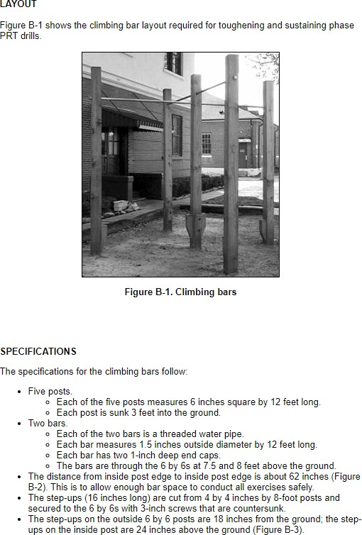
Unit Title: The ACFT Leg Tuck Event Activity Title: Hands on Practice Estimated Time: 30 Minutes
 | Instructional Activity Description On Ultima PRT field in proper uniform the instructor will conduct “by the numbers” demonstration for students on the leg tuck, bent-leg raise, leg tuck and twist, and alternating grip pull-up exercises On Ultima PRT field in proper uniform under instructor supervision the students will practice each exercise including the leg tuck, bent-leg raise, leg tuck and twist and alternating grip pull. Students will perform in pairs and receive feedback on performance from peers and instructors. Students will perform short collaborative reflection on learning experience and how to incorporate within future daily activities.
 | Activity Deliverables/Outcomes: Provide students with practical demonstration of content (crawl, walk, run) method. Students will apply new knowledge into practical application.
 | Resources Required: Instructor Guide NCOLCE Ultima Physical Readiness Training field Approved Army Climbing Bars IAW TC 3-22.20 Exercise Checklist Stopwatch
Notes: Create “by the numbers” exercise checklist for the leg tuck, bent-leg raise, leg tuck and twist, and alternating grip pull-up exercises Ensure student to approved climbing bar ratio is sufficient to meet the requirement of one student to one approved climbing bar Deconflict Ultima field use with SGM-A (S-4) for scheduling conflicts | Key learning objectives / sub-objectives: Students will imitate (psychomotor) new knowledge and skills for the leg tuck, bent leg raise, leg tuck and twist, and alternating grip pull-up IAW TC 3-22.20 Students will have the opportunity to reflect on experience and how to best integrate information gained for future progress within their fire team
 | Key Content Points: Demonstration Practical Application Reflection (Merrill's 5th principle Integrate) Reinforcement of lessons from previous units

Slide 9
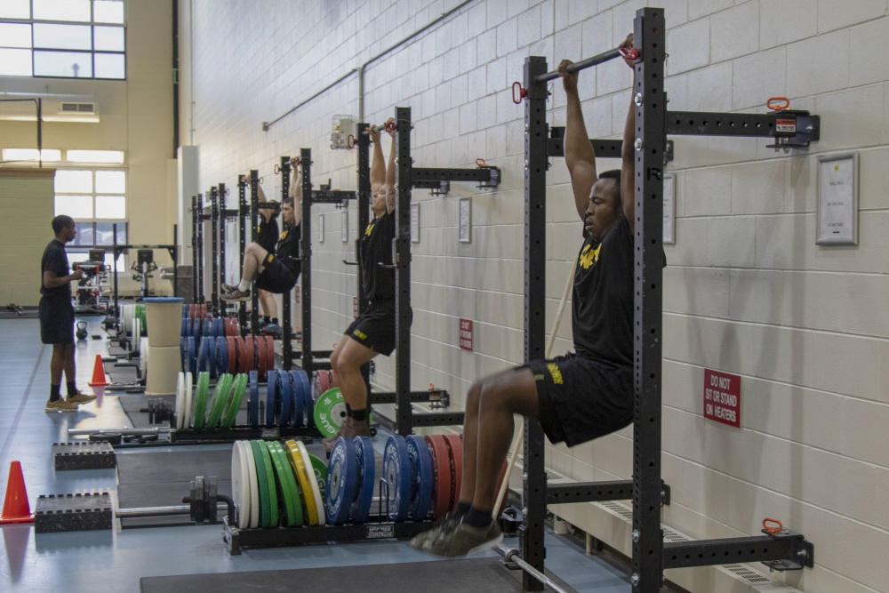
Unit Title: The ACFT Leg Tuck Event Activity Title: Individual Unit Application Estimated Time: 120 Minutes
 | Instructional Activity Description On Ultima PRT field in proper uniform the under-instructor supervision students will create a two-day (60 minutes per day) leg tuck PRT plan for approval and submit to commander. Planning will include resources required, timeline, risk mitigation strategy, and plan of action. Students under instructor supervision will lead fire team consisting of 2-4 soldiers through establish plan providing demonstrations, assessments, and feedback of soldier's performance in the leg tuck, bent-leg raise, leg tuck and twist, and alternating grip pull-up. Students will perform a collaborative reflection on learning experience and how to incorporate within future daily activities.
 | Activity Deliverables/Outcomes: Provide students with opportunity to create in a two-day leg tuck focused physical readiness training plan within the operational environment. Provide students with opportunity to apply training plan and knowledge of exercise execution to soldiers within assigned unit.
 | Resources Required: Instructor Guide NCOLCE Ultima Physical Readiness Training field Unit Soldiers Approved Army Climbing Bars IAW TC 3-22.20 Exercise Checklist Stopwatch
Notes: Adjacent unit coordination needed with applicable unit commanders for approval to facilitate established training goals and objectives to reduce impact on daily operations. Transportation must be coordinated to ensure movement of soldiers from unit to NCOLCOE Ultima PRT field. Create training timeline for unit application implementation Ensure proper instructor/facilitator ratio for students and soldiers. (one instructor per student) | Key learning objectives / sub-objectives: Students will imitate (psychomotor) new knowledge and skills for the leg tuck, bent leg raise, leg tuck and twist, and alternating grip pull-up IAW TC 3-22.20 at unit of assignment Students will have the opportunity to reflect on experience and how to best integrate information gained for future progress within their fire team
 | Key Content Points: Learning facilitated by demonstrating new knowledge and skills to create and implement new training plan and exercise demonstration, execution, and feedback Reflection (Merrill's 5th principle Integrate)

Slide 10
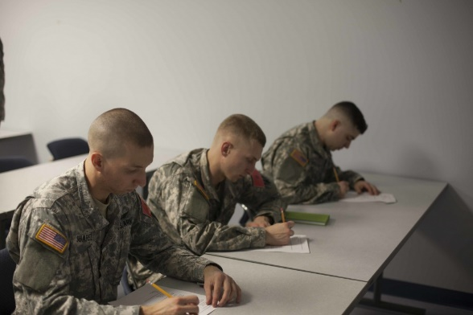
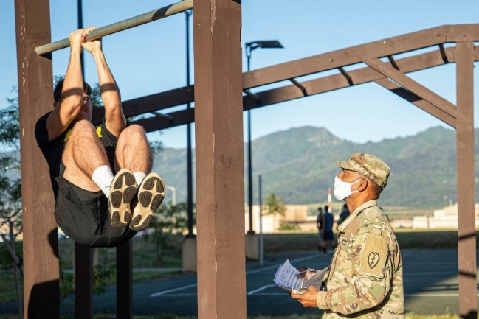
Unit Title: The ACFT Leg Tuck Event Activity Title: Evaluation/Conclusion Estimated Time: 30 Minutes
 | Instructional Activity Description Students will conduct a short ten question written post test followed by an assessed practical demonstration of the leg tuck and three training exercises Students will conduct a 15-question post course survey focused on instructional unit Students will turn in applicable course materials back to instructor Students who successfully pass written and practical application assessments will receive certificate of training for ACFT leg tuck
 | Activity Deliverables/Outcomes: Provide students with practical demonstration of content (crawl, walk, run) method Students will apply new knowledge into practical application
 | Resources Required: Instructor Guide Student Folders with handouts and student guide NCOLCE Classroom with student and instructor stations Post-Test Assessments Wi-Fi and Internet Access Post-Course Survey Student Certificates
Notes: Create ten question written assessment that includes previous five questions from course unit pre-test Create 15 question post course survey for instructional unit Create certificates of training | Key learning objectives / sub-objectives: Students will demonstrate through evaluation the key learning goals and objectives using both a written and practical application assessment IAW TC 3-22.20 Summative evaluation for instructional designer and course facilitators to improve instructional unit
 | Key Content Points: Student Knowledge and Skills assessment Summative Evaluation with use of end of course survey Course Material Turn-in
Written Evaluation
Practical Application Evaluation

Slide 11
U.S. Army NY National Guard. (2020, February 26). 200221-Z-JN745-0760. Flickr. https://www.flickr.com/photos/nyng/49589227412/.
EdHack. (2021). CREATE DIGITAL EDUCATIONAL RESOURCES. https://eduhack.eu/course/area-1/activity-3/.
U.S. Army. (2012). ACFT 2.0: Changes sparked by COVID-19. www.army.mil. https://www.army.mil/article/236479/acft_20_changes_sparked_by_covid_19.
U.S. Army NY National Guard. (2020, February 26). 200221-Z-JN745-0760. Flickr. https://www.flickr.com/photos/nyng/49589227412/.
Ahkam. (2017). Courses .ico PNG Transparent Background, Free Download #15339 - FreeIconsPNG. freeiconspng.com. https://www.freeiconspng.com/img/15339.
Unknown. (2021). Logos Discovery Engine. Ice Breaker Logos. https://www.logolynx.com/topic/icebreaker.
U.S. Army. (2018, October 15). Army Combat Fitness Test (ACFT) Event #5 - Leg Tuck. YouTube. https://www.youtube.com/watch?v=bXSHlJVjpIM.
U.S. Army. (2018, October 17). Four for the Core: Bent-Leg Raise. YouTube. https://www.youtube.com/watch?v=5YxbLOTcgbY&t=1s.
U.S. Army. (2016). Media Thumbs Photo. Proper Test Procedures. https://static.dvidshub.net/media/thumbs/photos/1603/2487791/1000w_q95.jpg.

